Slide 1


Signals & Systems for Computer Engineering
Prof.Dr. B.Berk ÜSTÜNDAĞ
Istanbul Technical University
Faculty of Computer Engineering and Informatics
BLG354E / CRN: 21615
6th Week Lecture (cont.)
2020
bustundag@itu.edu.tr
BLG354E / CRN: 21560
4th Week Lecture

Slide 2






Step Response of an LTI System:
Step response s(t) of a CT LTI system is defined as the response of the system when the input is u(t)
The step response s(t) can be easily determined by convolution to impulse response
Therefore s(t) can be obtained by integrating the impulse response h(t).
By differentiating s(t) with respect to t, we get
Step response s(t) of a system is one of the characterization methods
The impulse response h(t) can be determined by differentiating the step response s(t).
BLG354E - İTÜ Faculty of Computer Engineering and Informatics - Üstündağ

Slide 3








Eigenfunctions of Continuous-Time LTI systems
Eigenfunctions of continuous-time LTI systems represented by T are the complex exponentials e^{ST}, with s a complex variable
where
Eigenvalue of a continuous-time LTI system associated with the eigenfunction e^{ST} is given by H(s) which is a complex constant whose value is determined by the value of s

Slide 4












If λ is a complex constant and s is a complex variable then
in LTI systems
Proof:
Let y(t) be the output of the system with input
→
Since the system is time-invariant,
for arbitrary real t₀.
Since the system is linear
Setting t = 0, we obtain
Since t₀ is arbitrary, by changing t₀ to t, we can rewrite
or
where
BLG354E - İTÜ Faculty of Computer Engineering and Informatics - Üstündağ

Slide 5
Systems with or without Memory:
Since the output y(t) of a memoryless system depends on only the present input x(t), then, if the system is also linear and time-invariant, this relationship can only be of the form y(t) = Kx(t)
where K is a (gain) constant. Thus, the corresponding impulse response h(t) is simply
h(t) = Kδ(t)
Therefore, if h(t₀)≠0 for t₀≠0, the continuous-time LTI system has memory.

Slide 6


Casual LTI systems:
A causal system does not respond to an input event until that event actually occurs.
Therefore, for a causal continuous-time LTI system,
Stability:
Bounded-input/Bounded-output (BIBO) stability of an LTI system can be determined from its impulse response.
A continuous-time LTI system is BIBO stable if its impulse response is absolutely integrable:

Slide 7
Example:
k | u[k-1] | δ[k] | y[k]
0 | 0 | 1 | 1
1 | 1 | 0 | -1
2 | 1 | 0 | 2
3 | 1 | 0 | -4
4 | 1 | 0 | 8
5 | 1 | 0 | -16
6 | 1 | 0 | 32
7 | 1 | 0 | -64
8 | 1 | 0 | 128
9 | 1 | 0 | -256
10 | 1 | 0 | 512
11 | 1 | 0 | -1024
12 | 1 | 0 | 2048
Find the impulse response of the casual LTI DT system described by the difference equation:
y[n] + 2y[n – 1] = x[n] + x[n – 1]
x[n]= δ[n]→ y[n]=h[n]
h[n] =-2h[n–1]+δ[n]+δ[n–1]
Since the system is casual, h[-1] = 0. Then
k=0 : h[0] = -2h[-1]+δ[0]+δ[-1]= δ[0]=1
k=1 : h[1] = -2h[0]+δ[1]+δ[0]=-2+1=-1
k=2 : h[2] = -2h[1]+ δ[2]+δ[1] = -2(-1)=2
k=3 : h[3] = -2h[2]+δ[3]+δ[2] = -2(2) =-4
k=n : h[n] = -2h[n–1]+δ[n]+δ[n–1] = (-1)^{n}2^{n-1}
h[n] = δ[n] + (-1)^{n}2^{n-1}u[n-1]
→ IIR system
BLG354E - İTÜ Faculty of Computer Engineering and Informatics - Üstündağ

Slide 8
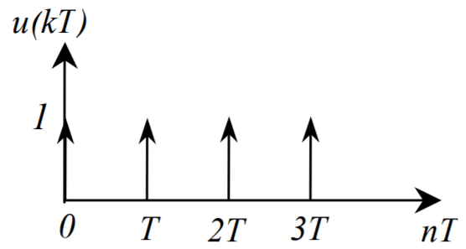
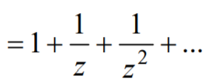







Solution by using the transfer function:
10th week:
y[n] + 2y[n – 1] = x[n] + x[n – 1]
Y(z)+2z⁻¹Y(z)=X(z)+z⁻¹X(z)
$$T\left(z\right)=\frac{Y(z)}{X(z)}=\frac{1+z^{−1}}{1+{2z}^{−1}}$$
X(z)
↔
Y(z)=T(z)X(z)
k | u[k] | u[k-1] | y[k]
0 | 1 | 0 | 1
1 | 1 | 1 | -1
2 | 1 | 1 | 2
3 | 1 | 1 | -4
4 | 1 | 1 | 8
5 | 1 | 1 | -16
6 | 1 | 1 | 32
7 | 1 | 1 | -64
8 | 1 | 1 | 128
9 | 1 | 1 | -256
10 | 1 | 1 | 512
11 | 1 | 1 | -1024
12 | 1 | 1 | 2048
x[n]= δ[n]={1} → X(z)=1
Y$\left(z\right)=\frac{1}{1+z^{−1}}+$ $\frac{z^{−1}}{1+2z^{−1}}$
Y$\left(z\right)=\frac{z}{z+2}+$ $\frac{1}{z+2}$
y(k)=Z⁻¹{Y(z)}
y$\left(k\right)=\left(−2\right)ku\left[k\right]+\left(−2\right)k_1u[k−1]$
y$\left(k\right)=\left(−2\right)k(u\left[k\right]−0.5u\left[k−1\right])$
This Photo by Unknown Author is licensed under CC BY-SA

Slide 9
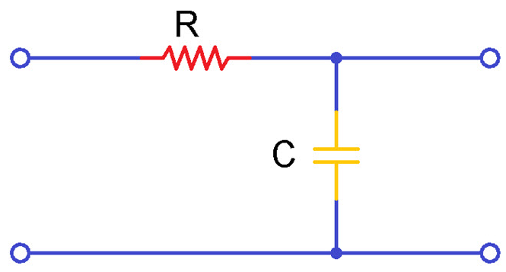


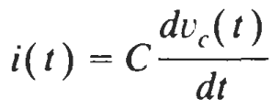


Systems Described by Differential Equations
Differential equations that describe physical behavior CT LTI systems can be converted into equivalent Transfer Functions.
Their transfer functions can be used to estimate their output for a given input signal.
They also enable characteristic analysis including the BIBO stability.
Remember the RC Filter Example:
Transfer
function
x(t)
Y(t)
V_{in}
V_{out}
T
x(t)=V_{in}
y(t)=V_{c}=V_{out}
A general Nth-order linear constant-coefficient differential equation is given by
Its general solution for a particular input x(t) is given by
where y_{p}(t) is a particular solution y_{h}(t) is a homogeneous solution satisfying the homogeneous differential equation

Slide 10

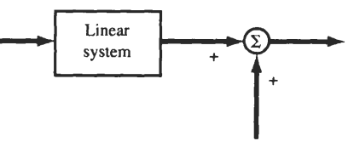

Linearity of LTI systems
The exact form of homogenous solution y_{h}(t) is determined by N auxiliary conditions
y_{zs}(t)
y_{zs}(t): Zero state response of the system
x(t)
y(t)
y_{zi}(t): Zero input response of the system
y_{zi}(t)
The system specified by set of differential equations will be linear only if all of the auxiliary conditions are zero.
If the auxiliary conditions are not zero, then the response y(t) of a system can be expressed as

Slide 11





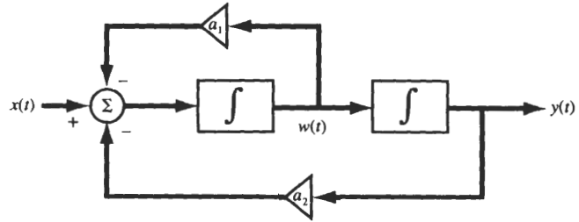
Example:
The following differential equation describes the input-output relationship of a physical system.
a) Find its CT LTI system block diagram
b) Find its Transfer Function (impulse response)
c) Find its output if the CT signal x(t)=2u(t) is applied to its input
d) Simulate its output y(kT) if for x(t)=2u(t) if the sampling
period T is 0.1seconds a₁=a₂=0.5
e₁(t)=x(t)-a₂y(t)
e(t)=e₁(t)-a₁y(t)
a₁
+
+
-
x(t)
∑
∑
ʃ
ʃ
y(t)
≡
-
e₁(t)
e(t)
w₁(t)
e(t)
a₂
BLG354E - İTÜ Faculty of Computer Engineering and Informatics - Üstündağ

Slide 12
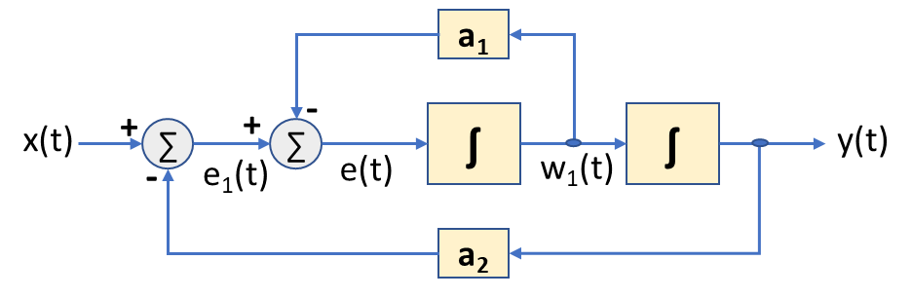

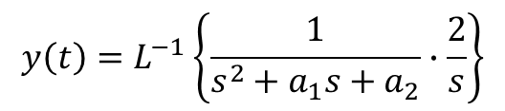

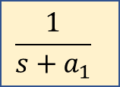
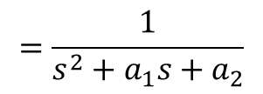


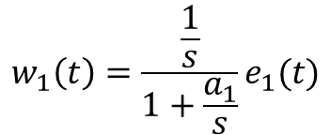

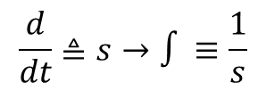
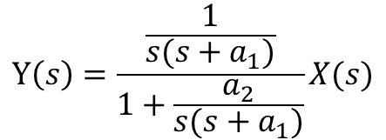
b)
$$\frac{d}{dt}≜s→∫≡\frac{1}{s}$$
For more detailed explanations:
Week7: Laplace Transform
ʃ
≡
$$\frac{1}{s}$$
a₁
-
$$w_{1}\left(t\right)=\frac{\frac{1}{s}}{1+\frac{a_{1}}{s}}e_{1}(t)$$
$$\frac{w_{1}\left(t\right)}{e_{1}(t)}=\frac{1}{s+a_{1}}$$
+
$$\frac{1}{s}$$
→
e₁(t)
∑
e(t)
w₁(t)
x(t)
+
$$\frac{1}{s+a_{1}}$$
$$\frac{1}{s}$$
y(t)
∑
-
e₁(t)
w₁(t)
a₂
$$Y\left(s\right)=\frac{\frac{1}{s(s+a_{1})}}{1+\frac{a_{2}}{s(s+a_{1})}}X(s)$$
$$T\left(s\right)=\frac{Y\left(s\right)}{X(s)}=\frac{1}{s\left(s+a_{1}\right)+a_{2}}$$
$$=\frac{1}{s^{2}+a_{1}s+a_{2}}$$
T(s)
X(s) for x(t)=2u(t)
c)
$$y\left(t\right)=L^{−1}\left\{\frac{1}{s^{2}+a_{1}s+a_{2}}∙\frac{2}{s}\right\}$$
d) Set t=kT and find y(t) for the given values
BLG354E - İTÜ Faculty of Computer Engineering and Informatics - Üstündağ

Slide 13
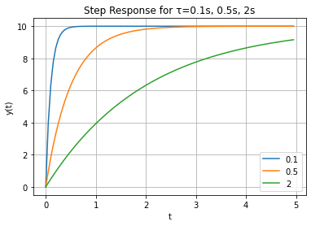
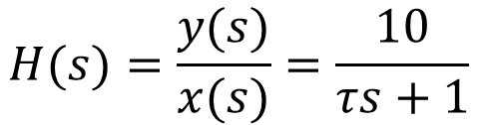

Step Response of 1st order Systems in Python
import control
import matplotlib.pyplot as plt
import numpy as np
Ts = [0.1, 0.5, 2] # time constants
K = 10
t = np.arange(0, 5, 0.05)
for T in Ts:
#Define the transfer function
num = np.array ([K])
den = np.array ([T , 1])
H = control.tf(num , den)
print ('H(s) =', H)
t, y = control.step_response(H, t) #Step Response
plt.plot(t, y) # Plot the output
plt.grid()
plt.xlabel("t")
plt.ylabel("y(t)")
plt.legend(Ts)
plt.title("Step Response for τ=0.1s, 0.5s, 2s")
plt.show()
$$H(s)=\frac{y(s)}{x(s)}=\frac{10}{τs+1}$$
$$y(t)=10(1−e^{−\frac{t}{τ}})$$
→
BLG354E - İTÜ Faculty of Computer Engineering and Informatics - Üstündağ

Slide 14
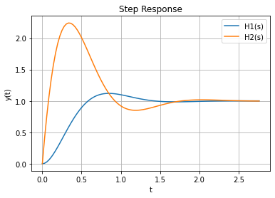


Step Response of a 2nd order System in Python
import control
import matplotlib.pyplot as plt
s = control.TransferFunction.s
H1 = (20)/(s**2 + 5*s + 20)
H2 = (15*s + 20)/(s**2 + 5*s + 20)
print ('H1(s) =', H1)
print ('H2(s) =', H2)
t, y = control.step_response(H1)
plt.plot(t,y)
t, y = control.step_response(H2)
plt.plot(t,y)
plt.legend(["H1(s)","H2(s)"])
plt.xlabel("t")
plt.ylabel("y(t)")
plt.title("Step Response")
plt.grid()
$$H1(s)=\frac{20}{s^{2}+5s+20}$$
$$H2(s)=\frac{15s+20}{s^{2}+5s+20}$$
BLG354E - İTÜ Faculty of Computer Engineering and Informatics - Üstündağ

